Slide 1
Analysis of INDIAN PREMIER LEAGUE
By:- ANKUR SONI (C) ANSH NAYAK BHARADWAJ CHINMOY JYOTI KASHYAP KALYAN BAISHYA ROHAN KULI IDEAS Project Presentation
Guide: Prof. MISS BIDISHA DOBE , IDEAS

Slide 2
Agenda
Introduction
Scope and Motivation
Details of Dataset
Tools and Technology
Visualization
Agenda
The analysis has been conducted in alignment with the primary objective of this project :-
Is spending a large amount of money actually impactful for different franchises? In other words, should a team during the auction process go for a really high-priced player or opt for a low to moderate valued player?
1/7

Slide 3
Agenda
Introduction
Scope and Motivation
Details of Dataset
Tools and Technology
Visualization
Introduction
The idea is to analyse the IPL data hosted by Kaggle to come up with something interesting and useful.
The insights from the dataset can really be helpful for the IPL management and team coach to improve themselves.
For the future progress, Machine Learning model can be applied to determine the probability of improvement on the basis of previous data.
1/7

Slide 4
Agenda
Introduction
Scope and Motivation
Details of Dataset
Tools and Technology
Visualization
Scope and Motivation
Predicting the winner of the next season of IPL based on past data can give us idea that which team has higher probability of winning the match which seems pretty interesting.
As a cricket enthusiast, working on this dataset was fun and getting the insights was interesting.
Predicting the outcome of the auction investments is a challenge but by means of inferential statistics and data visualization we can overcome the challenge to a certain extent.
1/7

Slide 5
Agenda
Introduction
Scope and Motivation
Details of Dataset
Tools and Technology
Visualization
Details of Dataset
The dataset was taken from the Kaggle and it contains the latest data of IPL.
The dataset has nearly 756 rows and 18 columns with some missing data and wrong data (which is mostly n/a values).
The dataset has detailed information about which team won the match by how much margin (wicket or runs depending on the team to opt for batting or bowling).
The dataset has columns telling about the man of match, venue, and the dataset was not sorted on the basis of season so sorting of data was done at beginning.
The column called Umpire3 in dataset was removed because more than 90% of data was missing.
1/7

Slide 6
Data Cleaning
In the Dataset there was lot of missing values in many rows and columns and cleaning the dataset is important to get graphs and insights without errors.
The matches where no result (maybe due to bad weather), the player of match and match-winner cannot be determined therefore data in those cells was filled with 'Not Possible'.
Missing data in the umpire column was replaced with the information present above the cell of missing data by the method of ‘ffill’.
In the city column the same city was written by two different names , some columns had Bangalore written in them and some have Bengaluru written.
1/7

Slide 7
Agenda
Introduction
Scope and Motivation
Details of Dataset
Tools and Technology
Visualization
Tools and Technology
The Tools used for the analysis of the dataset are python libraries like:-
Pandas :- Used to import the dataset in various format like csv ,excel etc. and also for the manipulation of data.
Numpy:-Used to do numerical analysis like finding mean, standard deviation and also in linear algebra.
Matplotlib :- It is used for visualization of data in meaningful graphs and charts.
Seaborn :- Is used for making the visualization creative based on matplotlib. It provide high level interface for creating graphs.
1/7

Slide 8
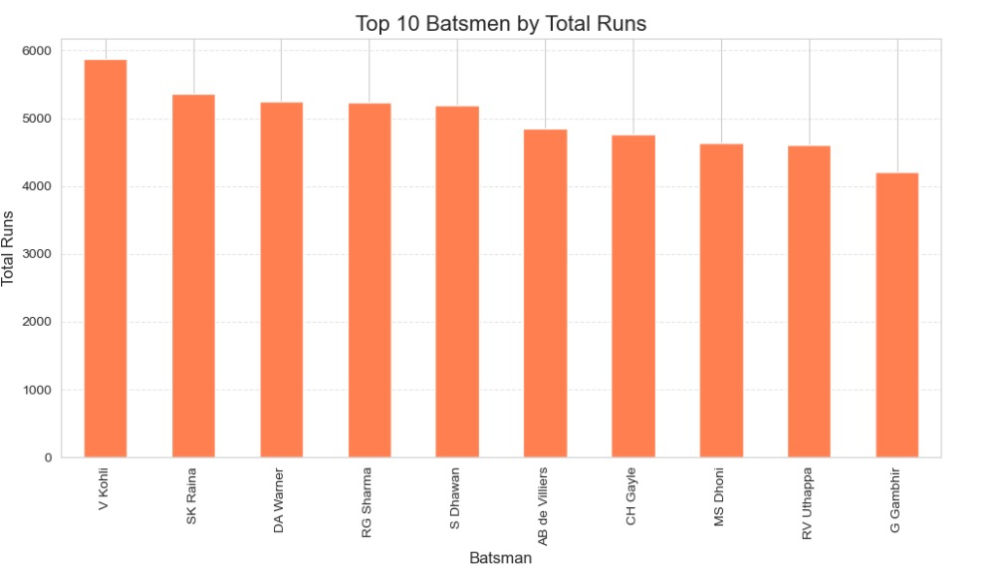
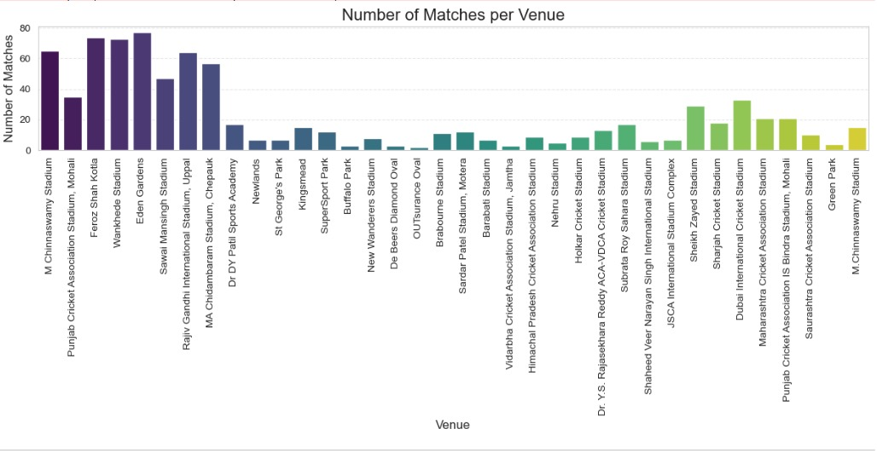
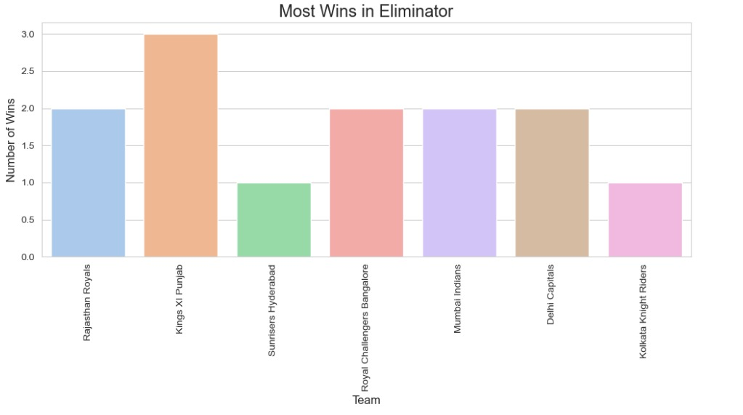
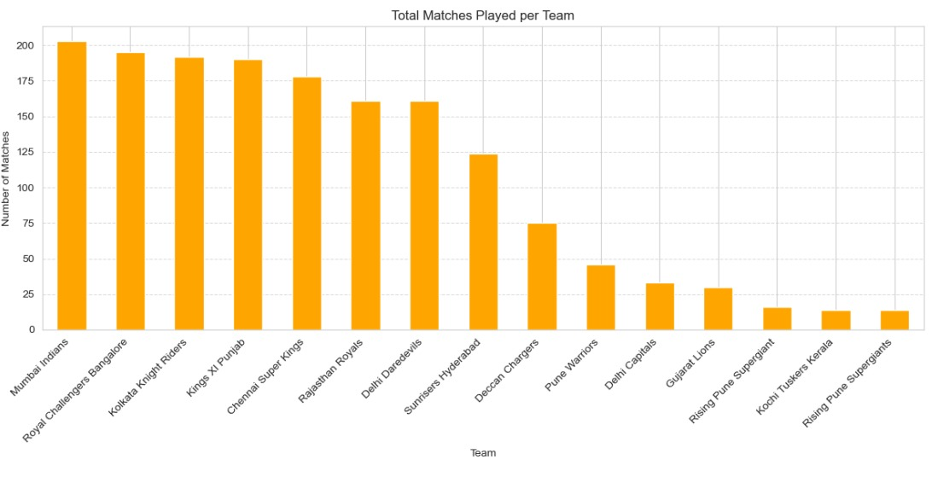
Agenda
Introduction
Scope and Motivation
Details of Dataset
Tools and Technology
Visualization
Visualization
1/7

Slide 9
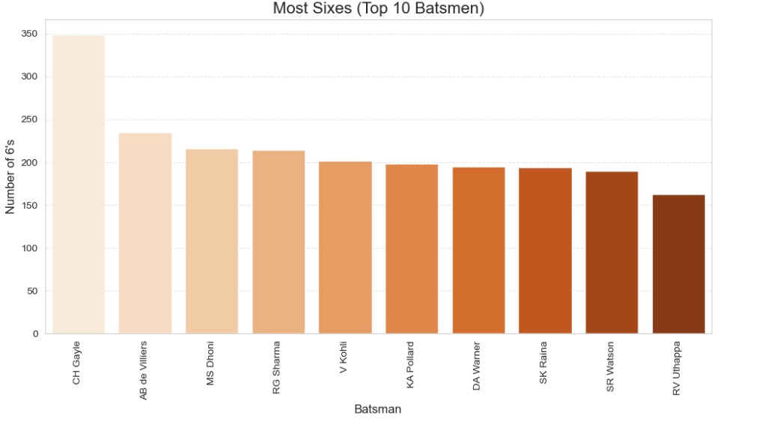
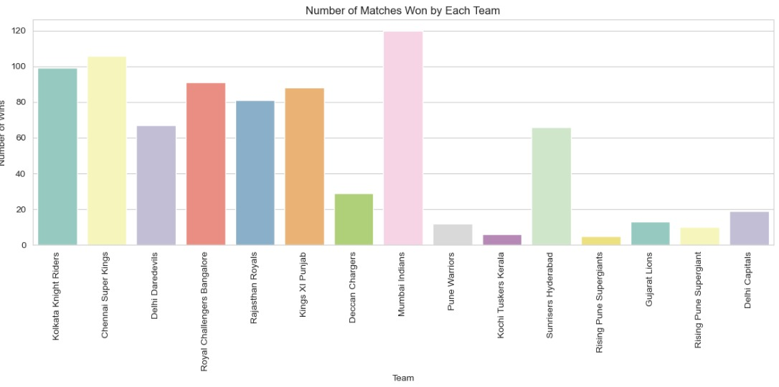
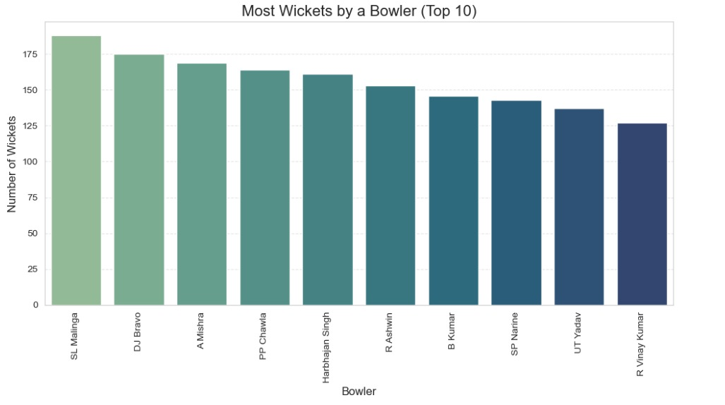
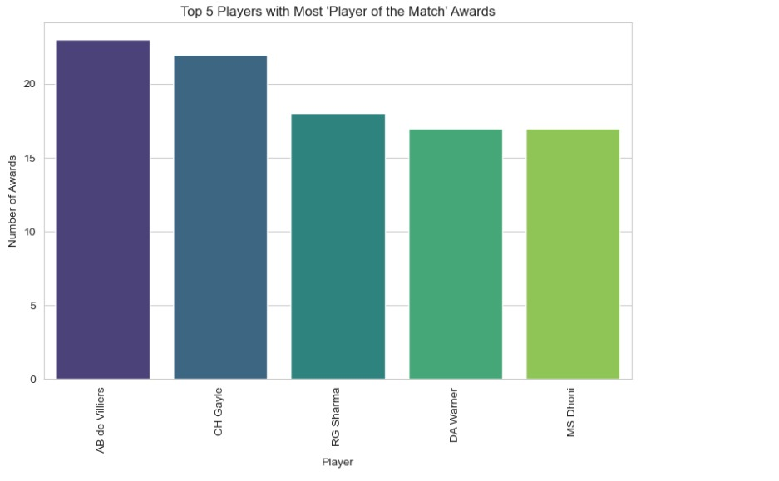
Agenda
Introduction
Scope and Motivation
Details of Dataset
Tools and Technology
Visualization
Visualization
1/7

Slide 10
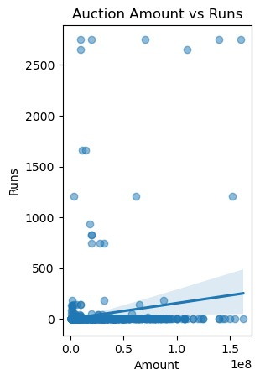
Agenda
Introduction
Scope and Motivation
Details of Dataset
Tools and Technology
Visualization
Visualization
“Does Big Spending Yield Big Scores?”
Weak positive correlation: There’s a slight upward trend-higher auction amounts may lead to more runs, but the relationship isn’t strong.
Data Distribution: Most players cluster at low auction values and moderate run counts.
Outliers Matter: A few high-price players with standout performance drives the subtle trend.
1/7

Slide 11
References
The dataset was taken from kaggle.com
For determining the outcome of the match, we referred to researchgate.net
For cross checking the details in dataset we referred to IPLT20.com
The dataset link is:-
https://www.kaggle.com/datasets/patrickb1912/ipl-complete-dataset-20082020
https://www.kaggle.com/datasets/kalilurrahman/ipl-player-auction-dataset-from-start-to-now
http://www.kaggle.com/

Slide 12
CONCLUSIONS
Totally 13 teams has participated in IPL History and few teams like: Pune Warriors, Kochi Tuskers Kerala, Rising Pune Supergiants, Gujarat Lions and Delhi Capitals has been only in 2 seasons and their success rate of is good when compared to other teams.
Virat Kohli has the most runs among top 10 batsman of all times in the IPL.
AB de Villiers has the most player of the match awards.
Lasith Malinga is the highest wicket taker of the Indian Premier League.
Christopher Henry Gayle has the most sixes in the Indian Premier League.
Eden Gardens has the most number of matches per venue.
Mumbai Indians has the most number of matches played among all other teams in the Indian Premier League.
Overall Chennai Super Kings and Mumbai Indians have high success rate and these two teams are the most successful teams of the Indian Premier League.

Slide 13
CONCLUSIONS
Core Insight: No strong correlation between auction price and player performance-expensive signings don’t guarantee results.
Unexpected Performers: Many mid-range players consistently outperformed costlier counterparts.
Metric Overview: Weak links across runs, wickets, strike rate, and economy rate suggest other influences like consistency, match availability and team dynamics.
Strategic Takeaway: Data-driven auction decisions are more effective than relying on reputation or past fame.
Optimization Opportunity: Overpaying for marquee players can disrupt squad balance and reduce cost efficiency.
Future Scope: Predictive modelling using broader contextual data (venues, opposition, match conditions) could improve auction outcomes.

Slide 14
*
Thank You

